Slide 1
Arduino Sensors
Human Computer Interaction 2

Slide 2
What is an Arduino Sensor?
Arduino sensors are devices that detect physical properties (like temperature, light, motion, etc.) and convert them into signals that can be read by an Arduino microcontroller. They allow projects to interact with the physical world.

Slide 3
Common Types of Sensors

Slide 4
Temperature Sensors
Temperature sensors in Arduino projects are used to measure temperature and can be interfaced with various Arduino boards for data collection, monitoring, and control applications.

Slide 5
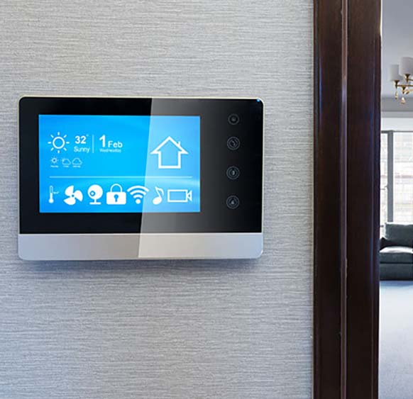
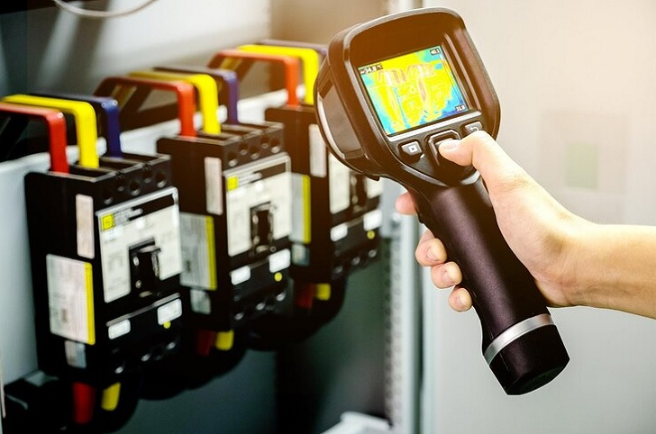
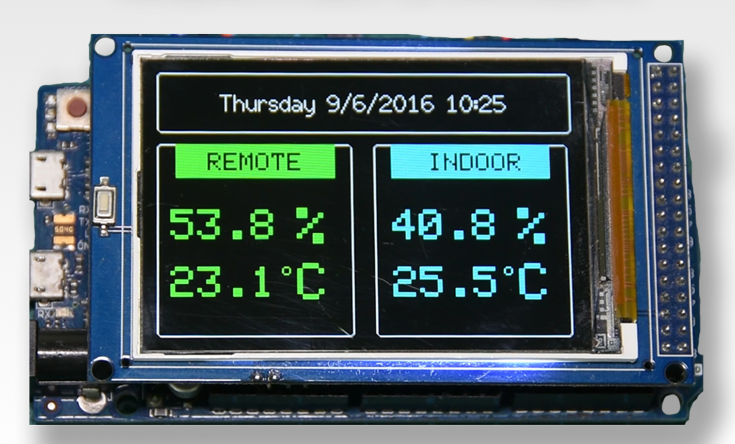
Temperature Sensors
industrial temperature monitoring
Weather Stations
Climate Control

Slide 6
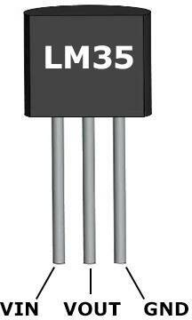
LM35
LM35
The LM35 is an analog temperature sensor that outputs a voltage proportional to the temperature in degrees Celsius.

Slide 7
Acronyms
LM35
VIN: Voltage Input - The voltage supplied to the Arduino board from an external source.
VOUT: Voltage Output - The voltage that can be output from the Arduino board.
GND: Ground - The reference point for the electrical circuit, often used as the return path for

Slide 8
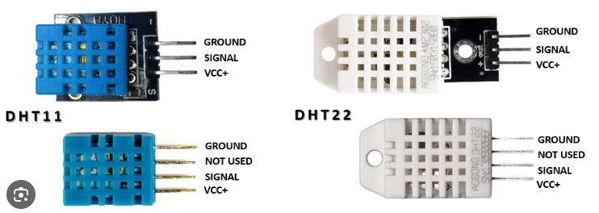
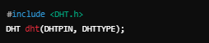
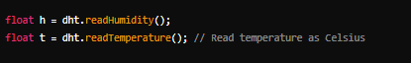
DHT11 / DHT22
These sensors provide both temperature and humidity readings. DHT11 is a basic version, while DHT22 offers higher accuracy and a wider range.

Slide 9
Acronyms
SIGNAL: This is the data output pin of the DHT11 sensor. It is used to send the temperature and humidity data to the microcontroller (like an Arduino).
VCC ( Voltage Common Collector ): This pin is the power supply pin. It typically connects to a positive voltage source, which is usually +5V or +3.3V.

Slide 10
Humidity Sensors
It uses a capacitive humidity sensor and a thermistor to measure the surrounding air, and sends a digital signal on the data pin

Slide 11
Light Sensors
Light sensors in Arduino projects are devices used to detect and measure light intensity.

Slide 12
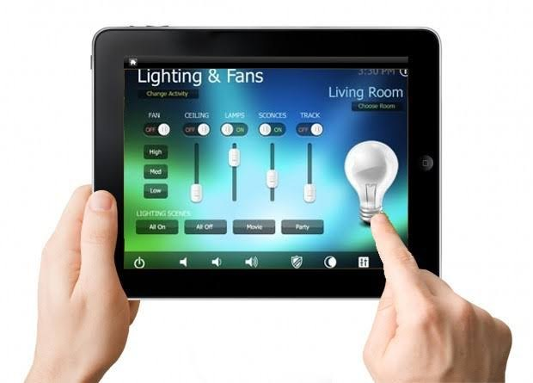

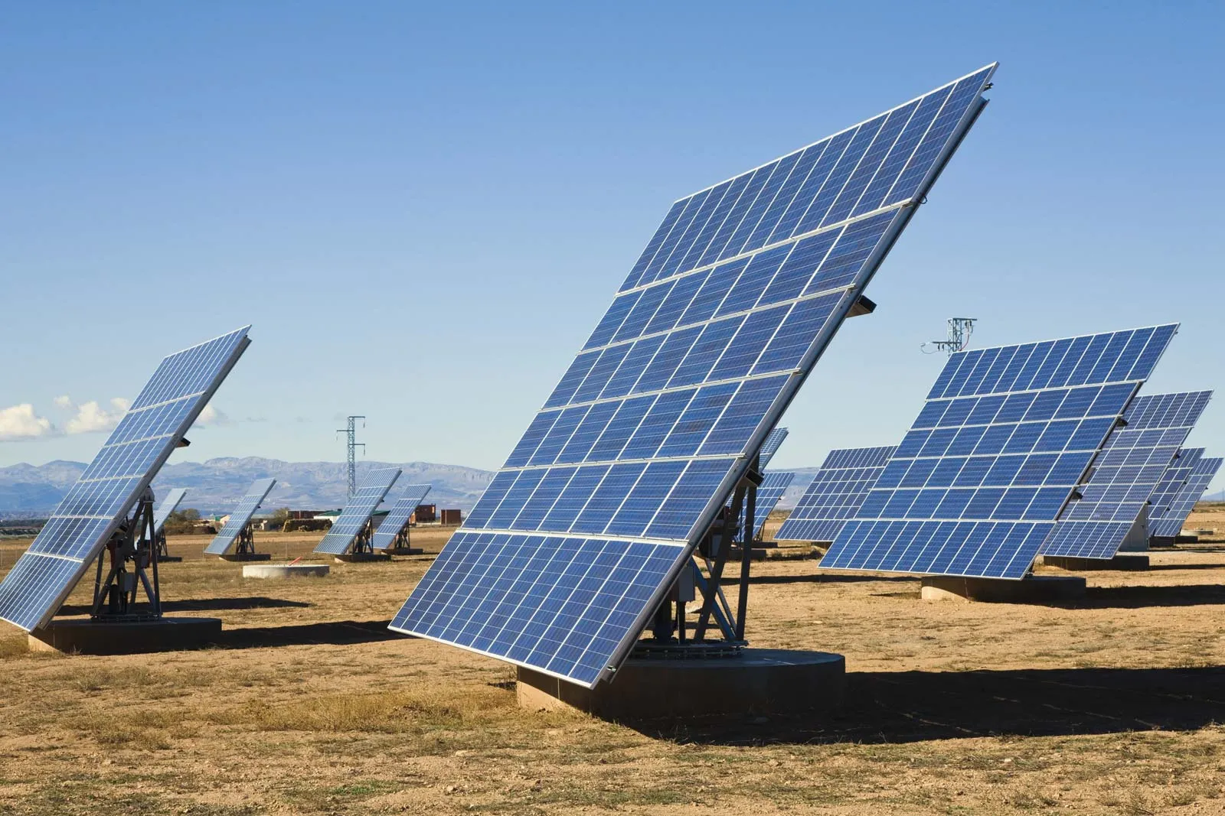
Temperature Sensors
Solar Trackers
Automatic lighting
Night lamps

Slide 13
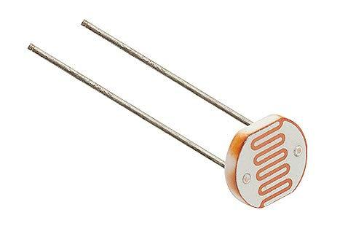

LDR (Light Dependent Resistor)
Photoresistor
An LDR changes its resistance based on the amount of light falling on it. More light results in lower resistance.

Slide 14
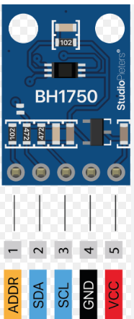
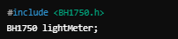
BH1750
A digital light sensor that measures light intensity in lux using I2C.

Slide 15
Acronyms
ADDR: Address - his refers to the unique identifier assigned to a device on a communication bus. In I2C (Inter-Integrated Circuit)
SDA: Serial Data Line - it carries the data being transmitted between the master and slave devices.
SCL: Serial Clock Timer - The master device generates the clock signal on the SCL line to synchronize data transmission

Slide 16
Motion Sensors
Motion sensors are devices used to detect and respond to movement in a given environment
When a warm body (like a human) passes in front, the sensor detects the change in infrared levels.

Slide 17
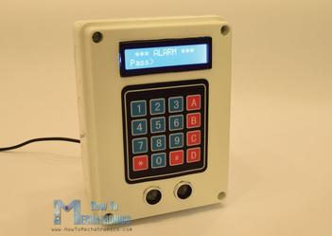
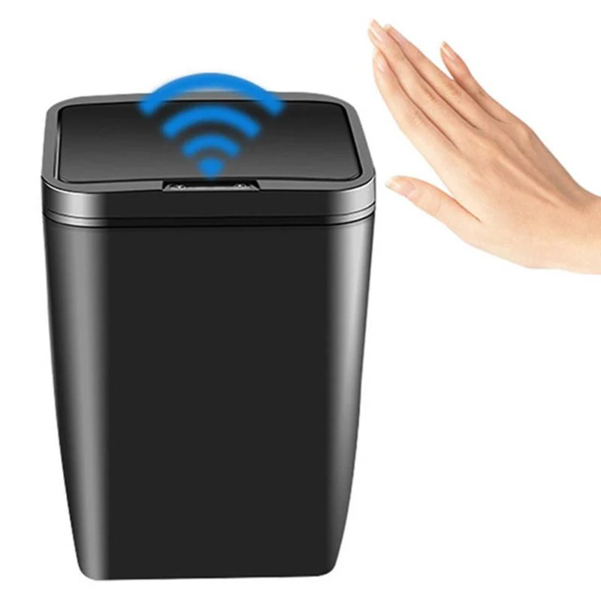
Motion Sensors
Automatic lighting
Security Alarms
Object Detection

Slide 18
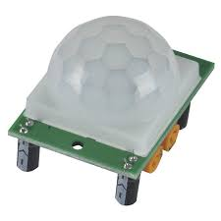
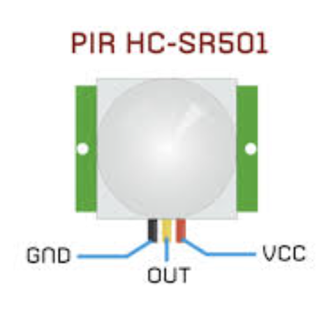
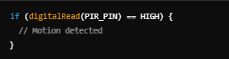
PIR (Passive Infrared) Sensor
Detects motion by measuring changes in infrared radiation from objects in its field of view.

Slide 19
Distance Sensors
Distance sensors are devices used to measure the distance between the sensor and an object.

Slide 20
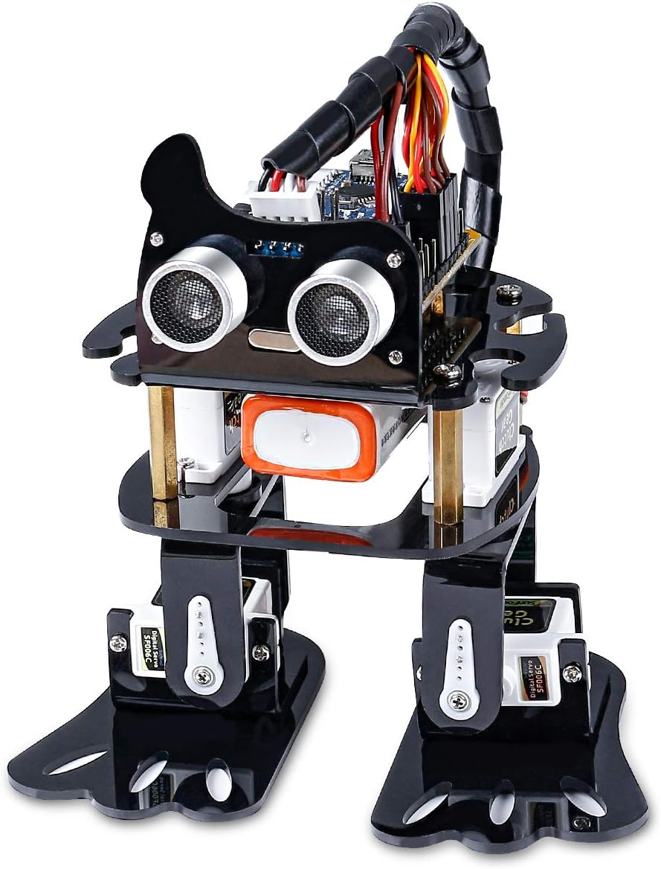
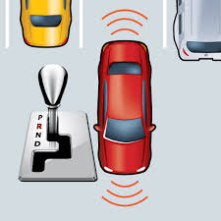
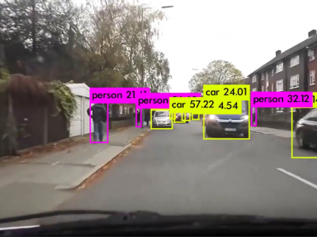
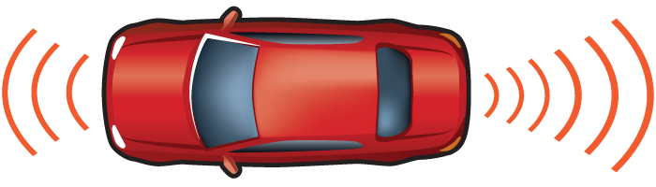
Motion Sensors
Obstacle Detection
Robotics
Parking Sensors

Slide 21
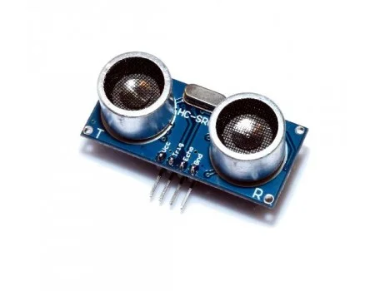
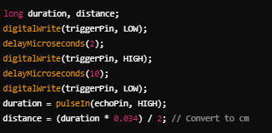
HC-SR04 (Ultrasonic)
Measures distance by sending an ultrasonic pulse and timing how long it takes for the echo to return.

Slide 22
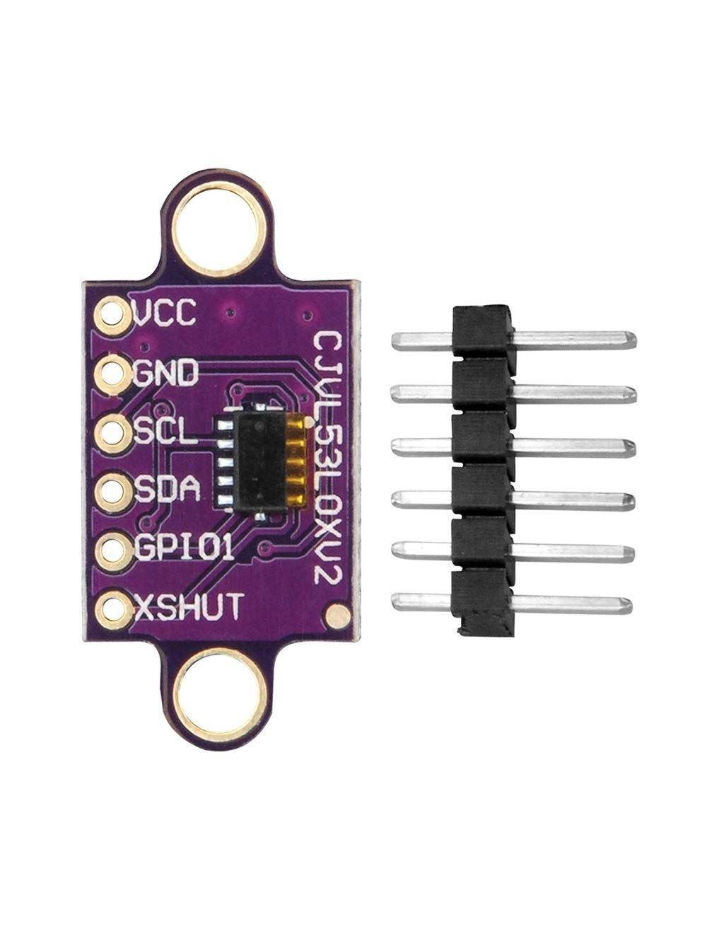
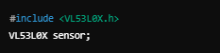
VL53L0X (Lidar)
A precise distance sensor that uses laser light to measure distances.

Slide 23
Gas Sensors
Gas sensors are devices used to detect and measure the concentration of specific gases in the air.
They change their resistance based on gas concentration.

Slide 24
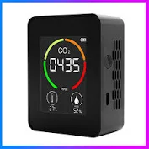
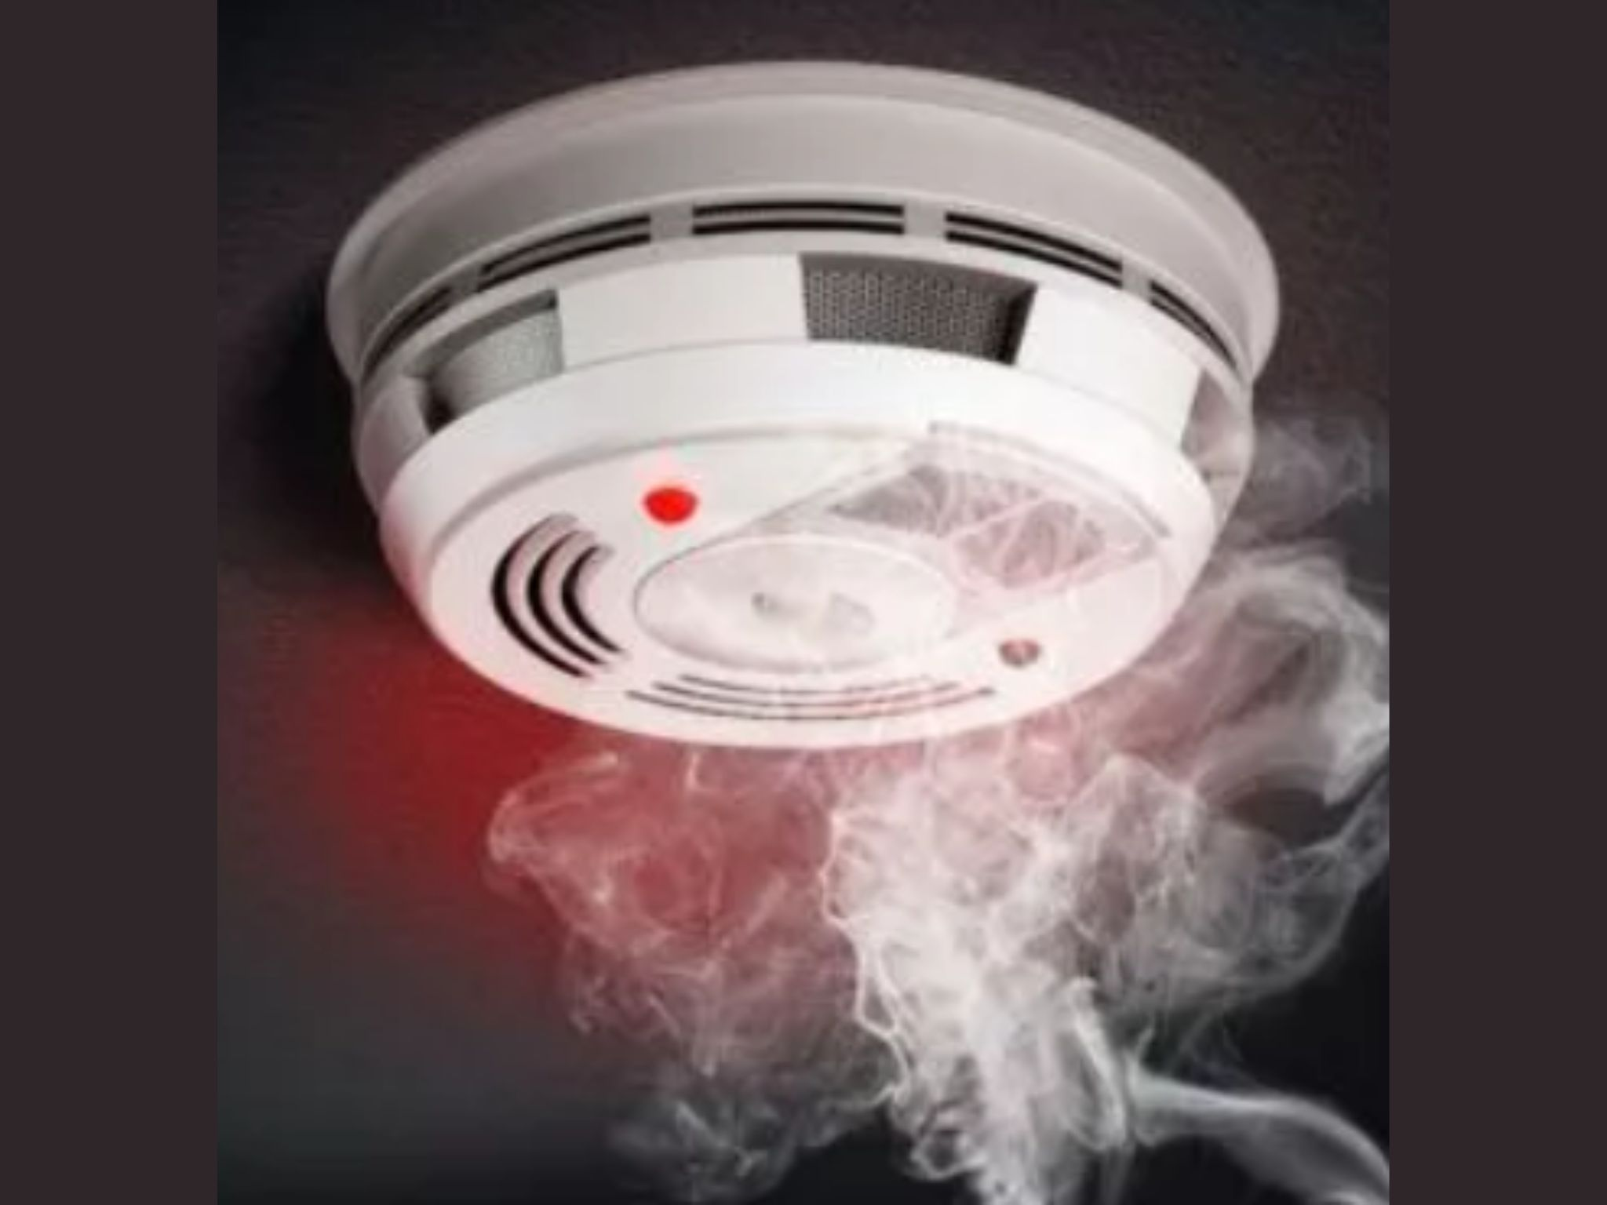
Motion Sensors
Air quality monitoring
Smoke Detection

Slide 25
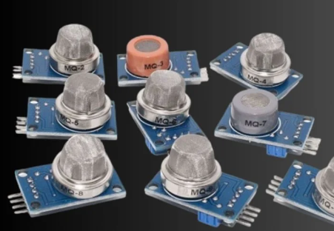

MQ Series (e.g., MQ-2, MQ-7)
These sensors can detect various gases (e.g., smoke, LPG, CO).

Slide 26
Accelerometers & Gyroscopes Sensors
Accelerometer sensors are devices that measure acceleration forces acting on an object.
They can detect changes in velocity and orientation

Slide 27
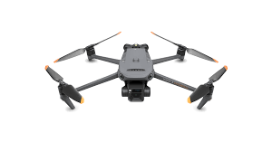
Motion Sensors
Robotics
Drones

Slide 28
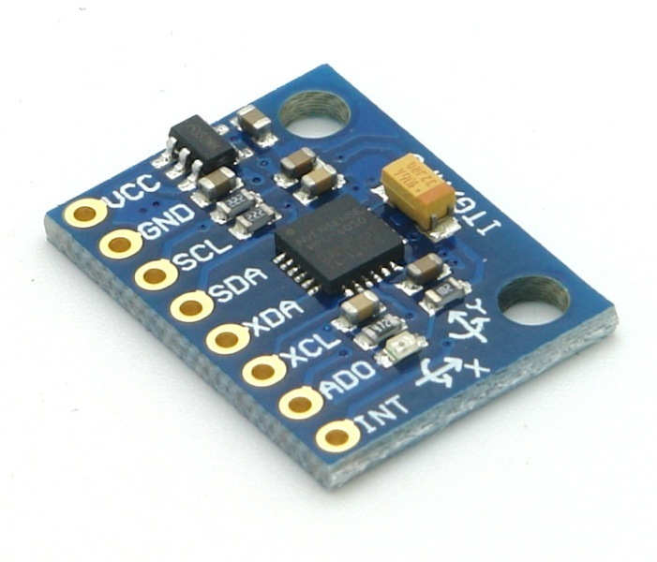
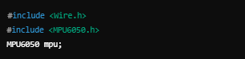
MPU6050
A 6-axis motion tracking device that combines an accelerometer and a gyroscope.

Slide 29
Acronyms
XDA: Extended Data Out - Refers to a type of DRAM that allows for faster data access by providing an extended data output feature.
XCL: eXtended Command List - Often used in the context of protocols or systems where a more comprehensive set of commands is available.
ADO: ActiveX Data Objects - A Microsoft technology that provides a programming interface for accessing data from a variety of sources.
INT: Interrupt - A signal that temporarily halts the execution of a program, allowing a different program to run.

Slide 30
Using Sensors

Slide 31
Research
Read the sensor’s datasheet to learn about its operating voltage, output type (analog or digital), and measurement range.
Explore online tutorials and documentation specific to the sensor and your intended application.
Look for example projects that use the same sensor to see how others have implemented it.

Slide 32
Gather Components
Collect all necessary components to ensure you can successfully build your project.
Sensor: Obtain the specific sensor you want to use (e.g., accelerometer, gas sensor).
Microcontroller: Ensure you have an Arduino board or compatible microcontroller.
Wires and Breadboard: Gather jumper wires and a breadboard (if needed) for prototyping.
Power Supply: Check if you need an external power supply or if the Arduino can power the sensor

Slide 33
Wiring
Follow the wiring diagram specific to your sensor and project. This often includes connecting power (VCC), ground (GND), and data/output pins.
Double-check connections to ensure they match the specifications (e.g., voltage levels and pin assignments) in the datasheet or tutorial.

Slide 34
Install Libraries
Ensure your Arduino IDE has the necessary libraries to communicate with the sensor and use its functionalities.
Open the Arduino IDE and navigate to Sketch > Include Library > Manage Libraries.
Search for the specific library that corresponds to your sensor (e.g., libraries for DHT sensors, MPU6050, etc.).

Slide 35
Using Supporting Components

Slide 36
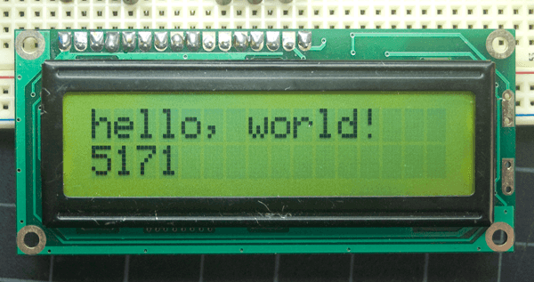
LCD
LCDs (Liquid Crystal Displays) are enabling real-time user interaction. They facilitate data visualization, control monitoring, and serve as effective educational tools.

Slide 37
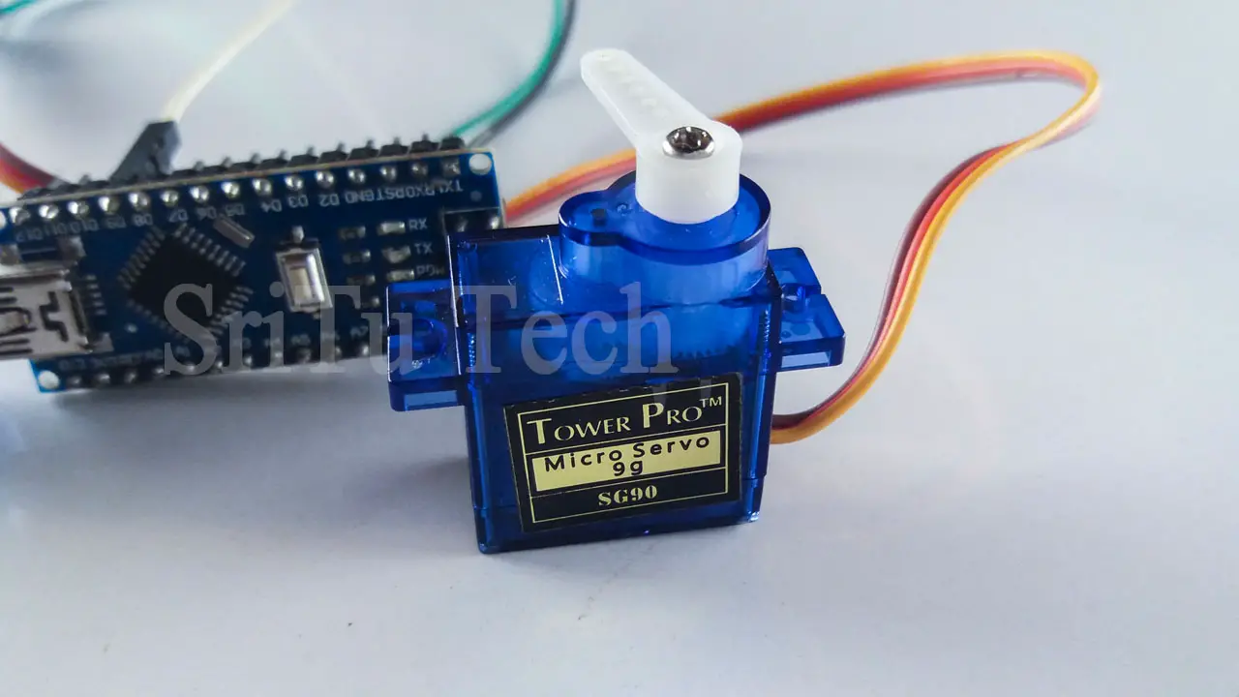
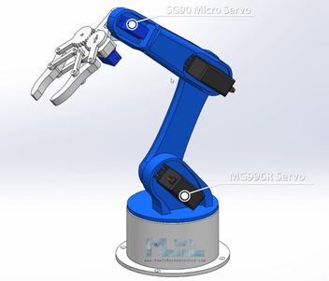
Servos
Servos are electromechanical devices used in Arduino projects to create precise rotational movements. They consist of a motor, gears, and a feedback system, allowing for accurate control of angular position.

Slide 38
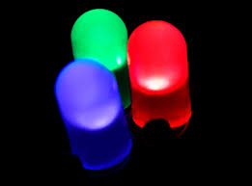
Lights ( Indicators )
LEDs are important indicators as they provide instant visual feedback on system status, are easy to integrate, energy-efficient, and versatile

Slide 39
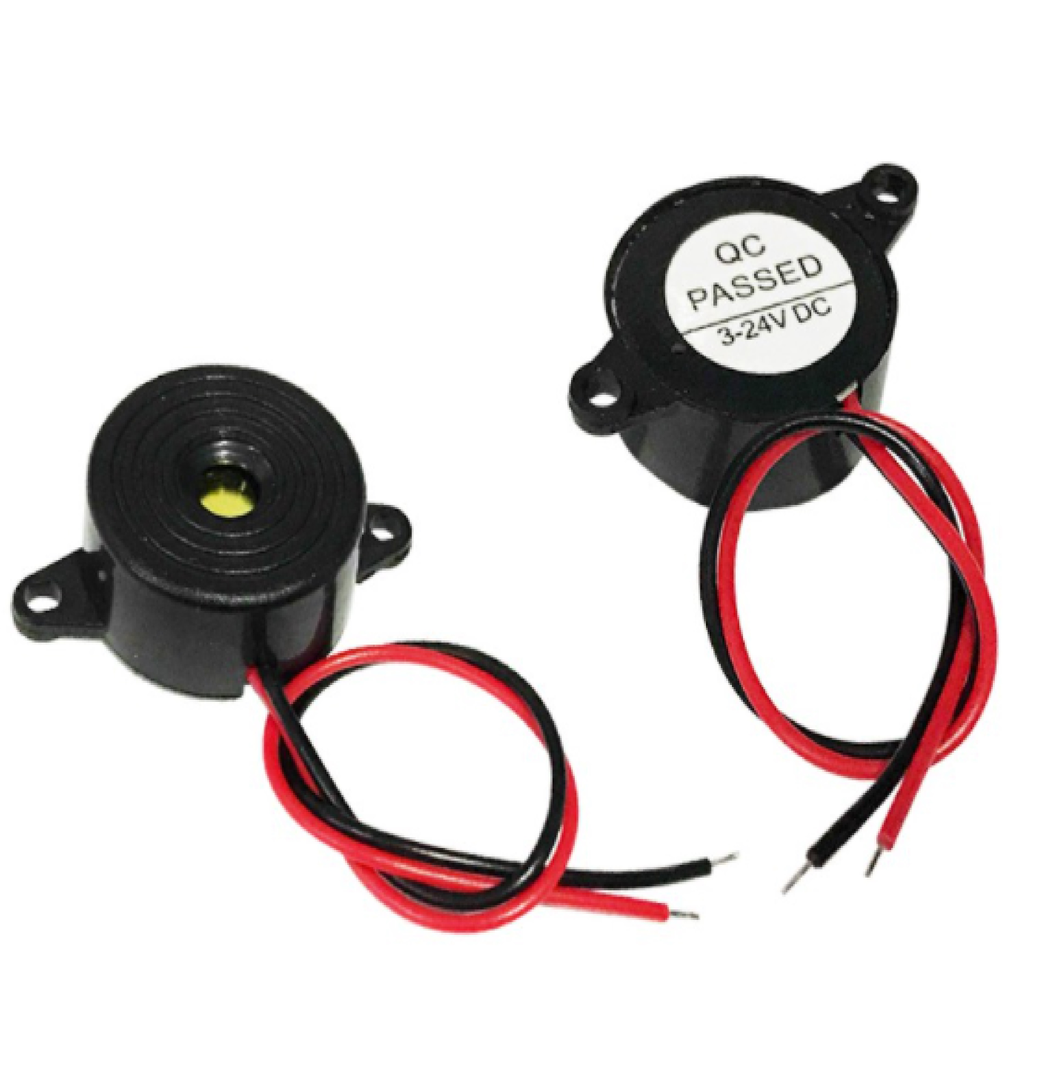
Buzzers ( Sounds Indicator )
Buzzers are crucial sound indicators because they provide immediate auditory feedback for system alerts, notifications, or warnings.

Slide 40
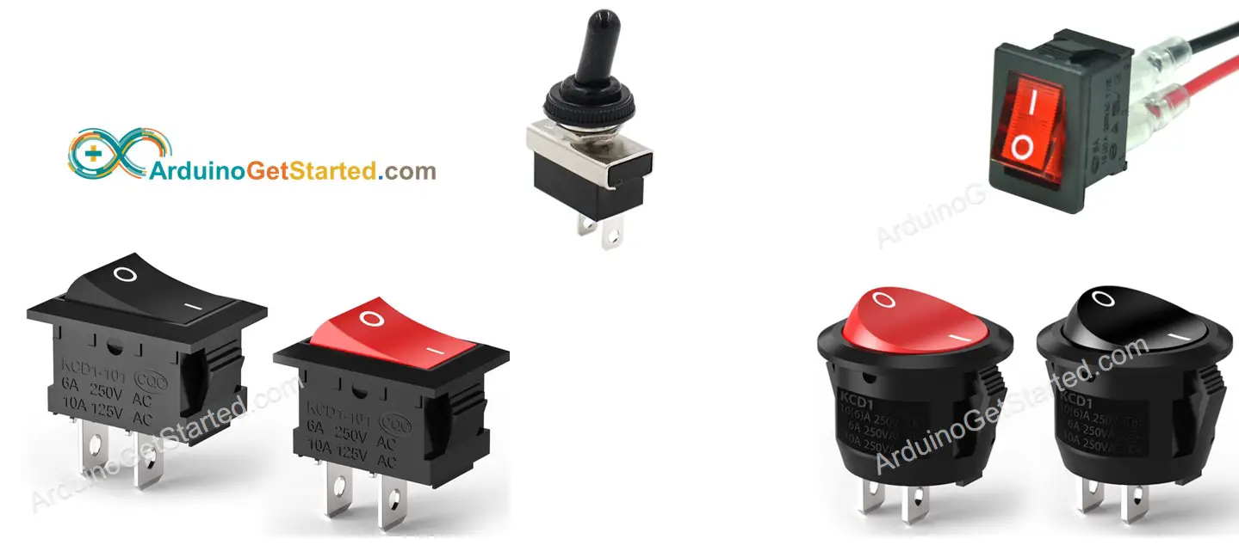
Switches
Arduino switches are important for providing user control over circuits, allowing users to easily turn devices on and off or input commands

Slide 41
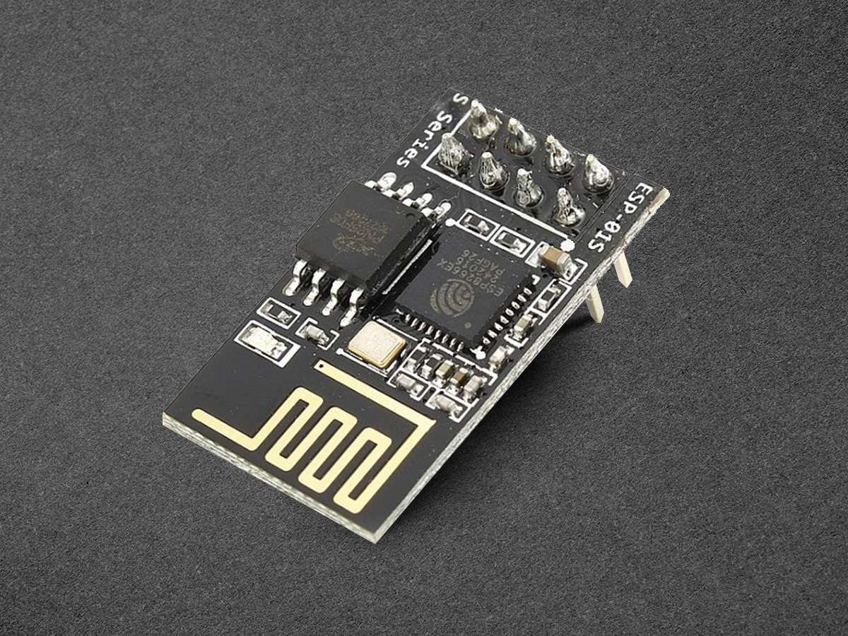
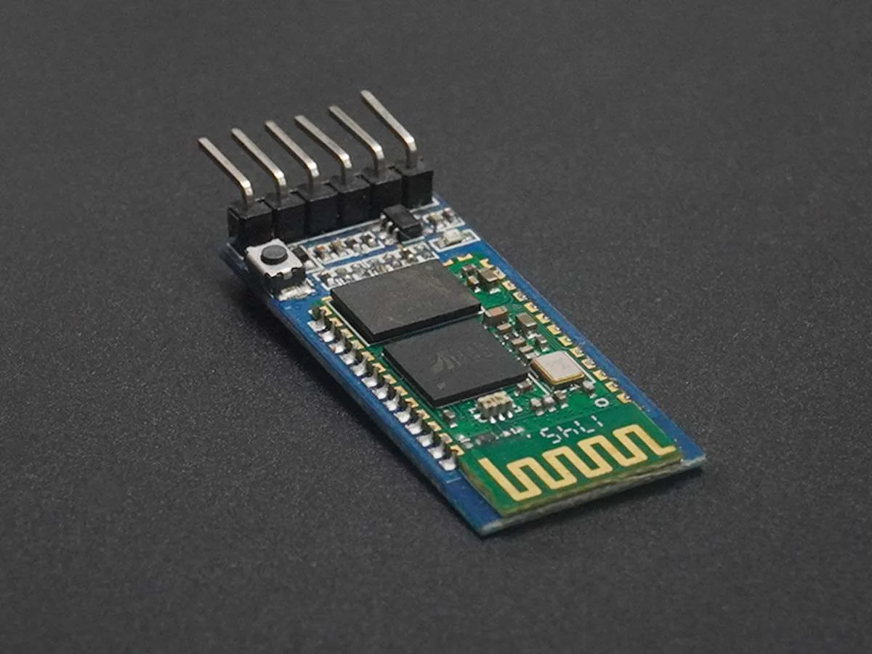
Wi-Fi and Bluetooth
Wi-Fi and Bluetooth modules are essential for enabling wireless communication in Arduino projects

Slide 42
BYE
CUTE KO NAMAN BEHHH

